Slide 1


SDP
LECTURE
The Iterator Design Pattern
Software Design Patterns
Diploma in IT
Year 2 (2024/25), Semester 4
4.2
Notes:
Hi everyone, the other design pattern that we will be looking at this week is called the Iterator design pattern.

Slide 2
The Iterator Pattern
Notes:
No weird examples this time, we’re going straight into it. What is the Iterator pattern? Allow me to explain.

Slide 3
Definition
The Iterator Pattern:
Provides a way to access the elements of an aggregate object sequentially without exposing its underlying representation
Also known as
Cursor
Notes:
The iterator pattern provides a way access the elements of an aggregate object sequentially without exposing its underlying representation. What does that mean? Let’s break this statement down. Firstly, the term || aggregate object refers to any object that is composed of other objects, in other words, a collection. Examples of aggregate objects include Lists, Arrays and Dictionaries, but could also be more complex structures like trees or heaps. Anyway, an aggregate object has a bunch of other objects in them. Next, the term || “sequentially” in this case does not mean from front to back, since some aggregate types have no front and no back. Instead, the Iterator pattern allows us to access the elements once and only once, so no elements are repeated and no elements are left out. Not only that, this sequence of elements does not have to be all the elements. For example, if we have a collection of weapons in a game, we could have an iterator that returns all the weapons, or all the melee weapons, or all the weapons that my halfling barbarian can use. Because, of course I will make a halfling barbarian. Finally, and this is the cool part of the Iterator pattern, we want to access these elements || without having to know how these elements are stored. This means that we can use the Iterator pattern the same way no matter whether we are talking about a List, an Array, a Linked List or something else altogether. How do we perform this magic? Let’s find out.
FYI, the Iterator pattern || is also known as the Cursor pattern.

Slide 4
Applicability
Often you may have to move through a collection (List, Queue, HashTable, Dictionary…)
If it’s an array, then this is easy
But it’s not trivial if it’s a more complicated data structure
Tree, dictionary, etc.
The code using the iteration should not have to know the details of the data structure being used
Notes:
bLet’s talk a bit more about why the Iterator pattern is cool. We know that there are many ways to store objects, such as a List, a Dictionary, or a Queue. C# provides several standard aggregate types, but there is nothing stopping you from creating your own aggregate type. For more on this, you might want to choose the Data Structures & Algorithms elective module. Sounds like I’m doing product placement.
One very common task is to go through the elements in a collection once and exactly once. This is easy to do if it’s an array, we just use a for loop and iterate the element at each index from 0 to size – 1. But what if it’s a more complicated data structure, such as a tree or a dictionary? For example, how would you retrieve each element in a tree once and only once? In such cases, you can’t just use foreach, and it seems like you will need to now how that data structure works in order to iterate through all the elements.
Ideally, what we want is to have access to code that || iterates through the collection, but hides the details of the data structure being used. We just want to call the methods and it will iterate through a collection for us.

Slide 5
Key Motivation
This pattern answers the question: How do you provide a standard interface for moving through a collection of objects whose data structure is unknown?
Notes:
In other words, we want to answer the question: how do you provide a standard interface for moving through a collection of objects whose data structure is unknown? The Iterator Pattern provides just such a standard interface, and this is the standard that everyone follows. All the cool kids are doing it.

Slide 6
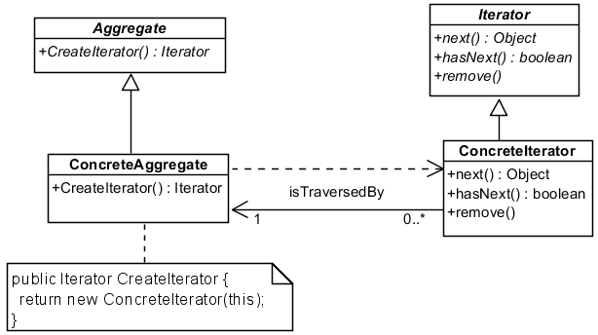
The Iterator Pattern
Client
Notes:
This is the class diagram for the Iterator pattern. The one that was originally proposed by the Gang of Four is slightly different, but this version contains all the essential elements.
Firstly, we have our || ConcreteAggregate class over here. This is the collection class that contains multiple objects. According to the Iterator design pattern, the ConcreteAggregate class inherits from the || Aggregate abstract class. Notice that the Aggregate abstract class has an abstract method CreateIterator() that returns an Iterator object, so the ConcreteAggregate needs to implement this method, and all it does is || return a new ConcreteIterator object. What is a ConcreteIterator object? Well, it’s || this class over here, which inherits from || this Iterator abstract class. All Iterators must implement 2 methods, as declared by the abstract methods in the Iterator abstract class. The || next() method returns the next element in the sequence that we are iterating through; the || hasNext() method returns true if there are more elements to return, and false otherwise. Clearly, in order to be able to return elements in the aggregate class, the ConcreteIterator must have a || reference to the ConcreteAggregate class. Note that we can also achieve this using interfaces instead of abstract classes.
So the whole idea of this design pattern is to describe an Iterator object and the methods that it provides to allow us to traverse some aggregate. So suppose we have some Client class that wishes to access an aggregate. This || Client class will of course have an association with the aggregate that it wishes to traverse, but it does not need to have a reference to a ConcreteAggregate. Similarly, it can use the CreateIterator() method to obtain a new Iterator object, but it does not need a ConcreteIterator object. In this way, we have a loose coupling between the client and the aggregate and iterator classes.

Slide 7
Key Participants
The Iterator defines the interface for accessing & traversing elements
next() advances to the next element and returns it as an Object
hasNext() returns true if there is another element in the aggregate, false otherwise
The Aggregate defines the interface for creating an iterator object
Notes:
To summarize, the Iterator Pattern defines 4 classes. There is an interface called || Iterator which defines two methods: the next() method returns the next object in the aggregate, and the hasNext() method tells us if there are more elements in the aggregate to iterate through.
We have another interface called Aggregate, which defines the createIterator() method for creating the Iterator object.

Slide 8
Key Participants
The ConcreteIterator
Implements the Iterator interface
Keeps track of current position
The ConcreteAggregate implements the Iterator creation interface to return an instance of a ConcreteIterator
Notes:
The ConcreteIterator implements the Iterator interface and keeps track of the current position in the collection. This is the class that does all the work of returning elements to the client.
And finally, the ConcreteAggregate is the collection class that we are iterating through. It implements the Iterator interface by having a method that returns a new ConcreteIterator object.

Slide 9
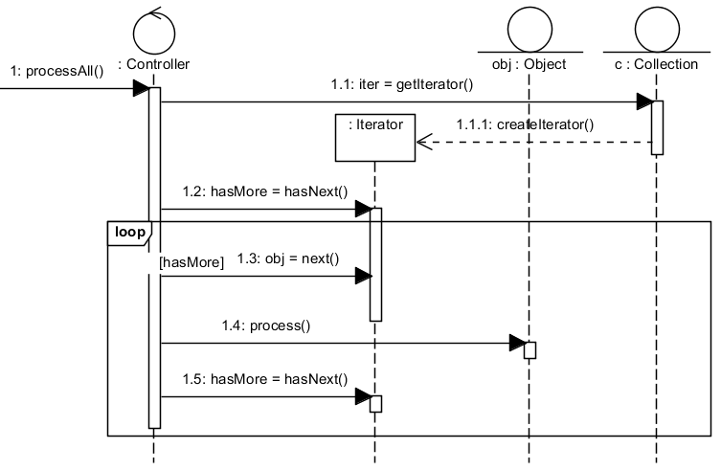
The Iterator Pattern
sd processAll
Notes:
RE-RECORD
Here is an example of how the Iterator Pattern is used. This is the sequence diagram for a method called || processAll that processes all the elements in a collection c. To use the Iterator pattern, the first thing we do is to || request for an iterator object from our collection class using the getIterator() method. The collection class will || create a new Iterator object, and this will be returned to the calling process and be stored as the variable iter. As we know, iter has the methods next() and hasNext(), as specified by the Iterator interface. To use it, we first check if there is a next item in the list by calling || hasNext(), which will return true if there is a next item, and false otherwise. If there is a next object, meaning hasMore is true, it will enter the loop. In each iteration of the loop, the object to process will be retrieved by calling || next(), we will || process it, and then finally we will || check again if there are any more items. This continues until we run out of items. Notice that c can be any collection class, whether it is a List or Tree or something else entirely. Assuming we follow the Iterator design pattern, this process remains the same.

Slide 10
User-defined Iterator Example
class OddIterator : Iterator {
List<int> values;
int position = 0;
public OddIterator(List<int> values) {
this.values = values;
// move position to first odd number
while ((position < values.Count) &&
(values[position] % 2 != 1))
++position;
}
Notes:
Here is an example of an Iterator. Suppose we want to have a type of ConcreteIterator called OddIterator which will move through all the odd values in a collection of integers, and in this example, we simply have a List. Since OddIterator is an Iterator, it must || implement the Iterator interface. And since this iterator is supposed to traverse a List, we must have a reference to that List, which we call values, that we || initialize in the constructor. We must also keep track of the current position that the iterator is pointing to. In this case, since it’s a List, we simply use an integer called || position to keep track of the current index, which we initialize to zero. However, we are an odd iterator, but the first element at position zero may not be an odd integer. Therefore, we need to “point” to the first odd integer in the list. To do so, we use a || while loop that checks if the value at the current position modulo 2 is equal to 1, meaning that the value is odd. If not, it will increment position and try again, until position is equal to values.Count, meaning it has reached the end of the List. So this constructor will create an OddIterator object with position equal to the index of the first odd integer in the List, or with position equal to the number of elements in the list if there are no odd integers at all.

Slide 11
User-defined Iterator Example
public bool hasNext() {
if (position < values.Count)
return true;
return false;
}
public object next() {
int oddvalue = values[position];
++position;
while ((position < values.Count) &&
(values[position] % 2 != 1))
++position;
return oddvalue;
}
Notes:
Now, we must implement the hasNext() and next() methods. The || hasNext() method is pretty straightforward. If position is not yet at the end of the List, then we have a next element, so it returns true, otherwise it will return false. As for the next() method, what it needs to do is return the current element, and then advance position to the next element. So first it || stores the current value in the variable oddvalue, then it || increments the value of position by 1. After that, we use the || same loop we used in the constructor to find the next odd value. Finally, we return the oddvalue that we stored in the beginning. Note that the next() method does not take into account the possibility that position is already past the end of the list. Instead, the Iterator pattern puts the responsibility on the user to check that hasNext() is true before calling next().
And that’s it. You can create any sort of ConcreteIterator for any collection class that you have created in a similar fashion.

Slide 12
User-defined Iterator Example
interface Iterator {
public bool hasNext();
public object next();
}
}
Notes:
For completeness, here is the Iterator interface, which could also have been implemented as an abstract class.

Slide 13
User-defined Iterator Example
List<int> list = new List<int>();
list.Add(5);
list.Add(4);
list.Add(7);
OddIterator iter = new OddIterator(list);
while (iter.hasNext()) {
Console.WriteLine((int) iter.next());
Notes:
Here’s an example of how we could use our spanking new OddIterator. We could create a List and add 5, 4 and 7 into it. Next, we can create an || OddIterator called iter that will go through our List and return the odd integers. We can then use it to write all the odd integers to screen in a || while loop that prints iter.next() as long as iter.hasNext() is true. Do note that we need to cast the return value of iter.next() into an integer since next() returns an object.

Slide 14
What Have We Achieved?
There is now a common interface for iterators
We do not need to know the data structure of the collection in order to enumerate it
More than one traversal can be done at the same time
Create multiple iterators
Multiple traversal methods can be created
Implement different ConcreteIterators
Notes:
Pretty neat, right? Let’s go over what the Iterator design pattern has achieved. We have || defined a common interface for iterators, which is followed and understood by everyone. And using this technique, the || data structure of the collection is encapsulated and hidden so that we do not need know what is the data structure in order to enumerate through it. Not only that, we can || create multiple Iterator objects to perform multiple traversals through the aggregate at the same time. Finally, this design pattern || allows us to implement multiple traversal methods by creating different ConcreteIterators. We could create an EvenIterator, a PrimeIterator, or even a LuckyDrawIterator that computes winning integers in some hidden way.

Slide 15
C# Implementation of Iterator Pattern
In C#, an iterator is called an enumerator
Aggregate Classes (e.g., List, Dictionary, Hashtable)
Such aggregate classes have a method GetEnumerator() that returns a reference object which implements the IEnumerator interface
If you wish to traverse every element in a standard C# aggregate class, it is simpler to use foreach
Notes:
The Iterator design pattern is so prevalent that it is part of standard C#, except that in C# it is called an enumerator. All of the standard C# aggregate classes like List, Dictionary or HashTable implement the || IEnumerator interface, which means that you can call the GetEnumerator method to obtain an iterator object for any of these aggregate classes. In most cases, if all you want to do is to traverse every element in a C# aggregate, it is || easier to just use foreach, but enumerators are available if you want to use it.

Slide 16
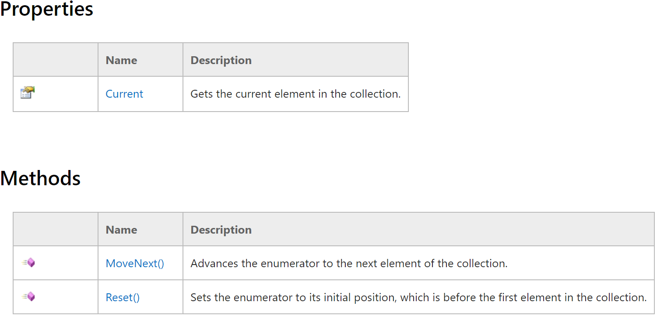
The IEnumerator interface
Notes:
The IEnumerator Interface uses slightly different terminology than what we have discussed, but it is used for similar purposes. It has an attribute Current that stores the current element. Since it is an attribute and not a method, getting Current does not advance the position of the enumerator. Instead, you need to call the || MoveNext() method to advance to the next element. MoveNext() returns a true if there is a next element, and false otherwise. Finally, the IEnumerator interface also declares a method called || Reset() that sets the enumerator to its initial position, which is before the first element of the collection. This means that before you can access Current, you must first call MoveNext() to set the position to the first element. The Reset() method is considered optional. If it is not implemented, C# specifies that it should throw a NotSupportedException. And if Reset() is not implemented, then if you want to reset the enumerator to the start of the collection, you should just create a new enumerator instead.

Slide 17
The IEnumerator Interface
At the start, the enumerator is positioned before the first element
You must call MoveNext() once to get to the first element
MoveNext() returns false if the iterator is past the last element, otherwise it returns true
If the aggregate is changed (e.g., a new element is added), the enumerator is invalid
MoveNext() and Reset() will throw an InvalidOperationException
Notes:
Here’s a quick summary of the C# IEnumerator interface. When you first create an enumerator, || the position is pointing to before the first element. Therefore, you must call MoveNext() once before you an get the first element via the Current attribute. The || MoveNext() method will move the position to the next element and return true, unless it will move past the last element, whereupon it will return false. Do take note that you are not allowed to || modify the aggregate as you are using the enumerator by, say, adding or removing elements from it. If that happens, MoveNext() and Reset() will throw an InvalidOperationException.

Slide 18
List Example
List<int> list = new List<int>();
list.Add(5);
list.Add(4);
list.Add(7);
IEnumerator<int> iter = list.GetEnumerator();
while (iter.MoveNext()) {
Console.WriteLine( (int) iter.Current);
}
Notes:
Right, so how do we use an IEnumerator in C#? Here’s an example where we can use it to print all the integers in a list. We create an || IEnumerator object using the GetEnumerator() method in our List. We can then use a || while loop that continues as long as iter.MoveNext() returns true. In each iteration, we WriteLine iter.Current, and remember to || cast it to the appropriate data type. Of course, if all you are doing is to traverse all elements, then it is better to use foreach instead. However, you can create your own enumerator class that inherits from the IEnumerator interface that does other things, such as traverse through all odd integers.

Slide 19
Summary
The Iterator design pattern
Next:
The Singleton design pattern
Gang of Four design patterns overview
More design principles
Notes:
RE-RECORD
And that was the Iterator design pattern, which is known as Enumerator in C#. It specifies an Iterator class that allows access to an aggregate’s elements without exposing its internal structure. The Iterator takes the job of iterating over an aggregate and encapsulates it in another object, so we relieve the aggregate of the responsibility of supporting operations for traversing its data. With the Iterator pattern, anyone can create their own Iterator that traverses through an aggregate to retrieve the elements that they want.
Incidentally, what do you call a list of sick elements that can’t read? Ill iterates. Byee!

